Slide 1
SQL -Some interesting facts about SQL
Full name of SQL --- Structural Query Language
Old name --- SEQUEL (Structural English QUEry Language)
First developed at IBM's San Jose (now Almaden) Research Lab. in 1974.
Over 100 SQL-based products in the market.
E.g.: Oracle, Sybase, Ingres, Informix, DB2.

Slide 2
Cont…
The first SQL standard (SQL-86) was published in 1986 by ANSI. (about 100 pages).
SQL1 was also adopted by ISO in 1987.
A major revision made in 1989 (SQL-89).
The second SQL standard (SQL2) was announced in 1992. It has about 600 pages.
The third SQL standard (SQL3) is under discussion. Expected release time: 20??

Slide 3
Major Components of SQL
DDL --- Data Definition Language used to define tables.
DML --- Data Manipulation Language (Interactive DML, ISQL) used to manipulate data directly.
Embedded DML (Embedded SQL) which supports the manipulation of data from a program in a high-level programming language.
View Definition used to create different ways to look at a database.
Authorization (DCL).
Integrity Constraints which defines various constraints on the data.
Transaction Definition which defines which group of commands should be treated as an atomic command.

Slide 4
Domain Types in DB2
CHAR(n) --- fixed length character string of length n, n < 254
varchar(n) --- variable length character string of length up to n, n <= 4000
DECIMAL(n,m) --- float point of n digits, of which m digits are after the decimal point, n >= m >= 0
REAL --- single precision floating point Values
Range: -3.402E+38 ~-1.175E-37 OR 1.175E-37 ~-3.402E+38 OR 0
Integer --- integer of up to 10 digits
Range: -2147483648 ~2147483647
DATE--- DD-MM-YY
TIME-HH.MM.SS
TIMESTAMP: DD-MM-YY-HH.MM.SS.000000

Slide 5
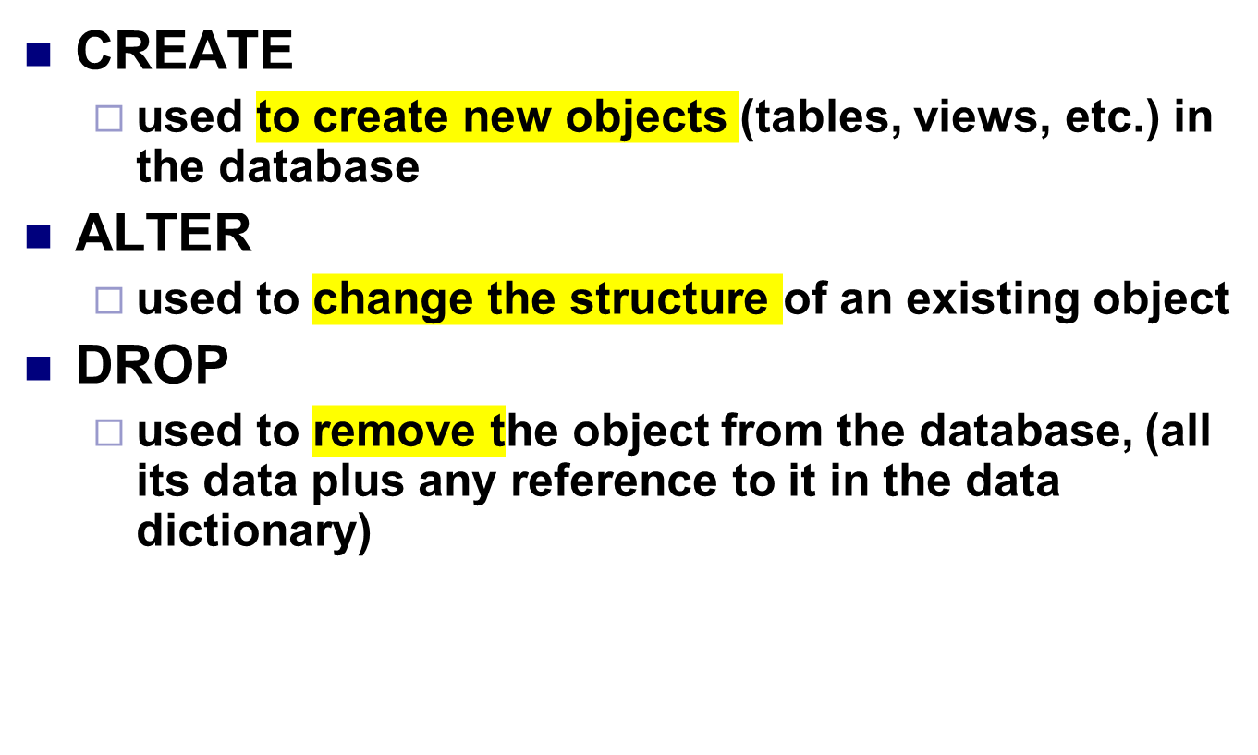
THE DATA DEFINITION LANGUAGE (DDL) in SQL

Slide 6
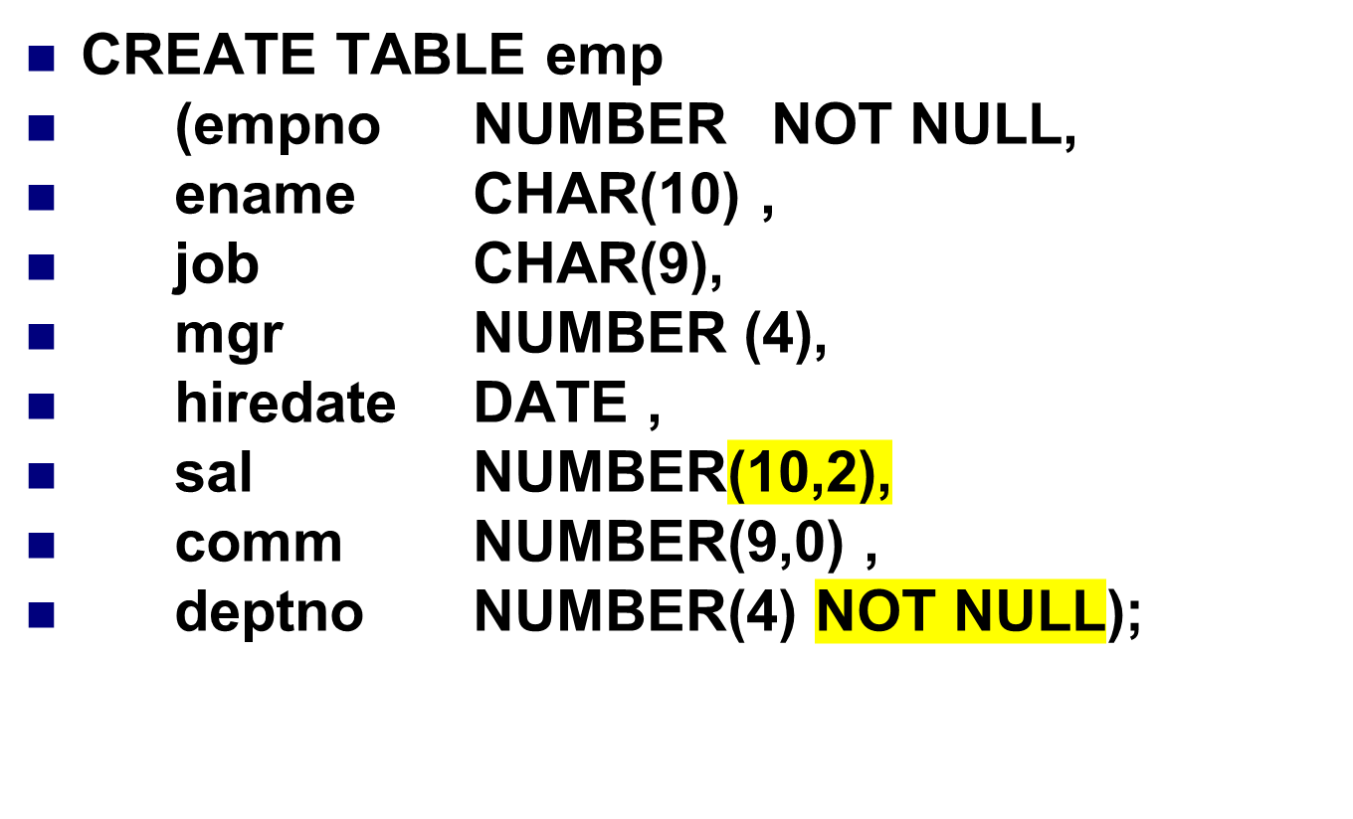

Create table command

Slide 7
Integrity Constraints
Integrity constraints are rules or regulations imposed on data to ensure their integrity and correctness.
Constraints on individual columns.
Constraints on a table.
Constraints on multiple tables.
type: values must be of the given type
not null: no null value can be taken
unique: no identical non-null values
primary key: no null value and no identical values
references to another attribute S(B): any non-null value must be currently under S(B).

Slide 8
Some constrains
CREATE TABLE emp
(empno NUMBER NOT NULL primary key,
ename CHAR(10) NOT NULL CHECK (ename = UPPER (ename))
job CHAR(9),
mgr NUMBER REFERENCES emp(empno),
hiredate DATE CHECK (hiredate <=SYSDATE),
sal NUMBER(10,2)CHECK sal > 500,
comm NUMBER(9,0) DEFAULT NULL,
deptno NUMBER(2) NOT NULL REFERENCES dept(deptno));

Slide 9
ALTER the table structure
To add a new column
ALTER TABLE <tablename>ADD (column_name datatype);
ALTER TABLE emp ADD (gender CHAR(1));
To change the definition of an existing column.
ALTER TABLE <tablename> MODIFY (column_name datatype);
ALTER TABLE emp MODIFY (deptno NUMBER(6));
To drop a column
ALTER TABLE <tablename> DROP (column_name);
ALTER TABLE student DROP Address;

Slide 10
DROP TABLE
The DROP TABLE command allows you to destroy an existing table.
If we want to permanently remove the student table that we created:
DROP TABLE student
An Introduction to Database System

Slide 11
DML modifying contents
INSERT allows insertion of records into a table
UPDATE updates existing rows in a table
DELETE removes unwanted rows from a table

Slide 12
Insert
INSERT INTO emp (empno, ename, job, mgr, hiredate, sal, comm, deptno)
VALUES(7500, 'CAMPBELL', 'ANALYST', 7566, '30-OCT-1992', 24500,0, 40);

Slide 13
Update Command
1)UPDATE emp SET comm = 0;
To give a 15% raise to all Analysts and Clerks in department 20 could use;
UPDATE emp
SET sal = sal* 1.15
WHERE (job = 'ANALYST' OR job = 'CLERK') AND deptno = 20;

Slide 14
Delete command
i.e. To remove from EMP all sales staff who made less than 100 commission last month enter:
DELETE FROM emp
WHERE job = 'SALESMAN'
AND comm < 100;
To delete everything in a table :
DELETE FROM <tablename>;

Slide 15
Basic Structure of an SQL Query
select target-attribute-list
from table-list
where conditions
Relational algebra correspondence:
select-clause projection ( )
from-clause Cartesian product ( )
where-clause selection ( )
选择表中的某些字段
从哪张表中
条件

Slide 16
Relation schemas under consideration:
Students (SID, Name, GPA, Age)
Courses (Course_no, Title, Dept_Name)
Enrollment (SID, Course_no, Grade)
Inserting Tuples into a Table: DML
insert into Students values (2006006004, 'LIZI', 20, 3.54);

Slide 17
CONT…
Find the SID, Name , GPA and AGE of all students whose GPA is higher than 3.01.
select SID, SName, GPA,AGE
from Students
where GPA > 3.01;

Slide 18
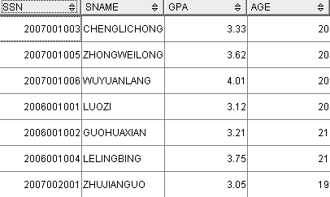
Cont…

Slide 19
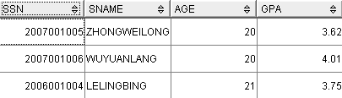
To retrieve all attributes of a relation, use the *
Find all students whose GPA is higher than 3.5.
select * from Students where GPA > 3.5

Slide 20
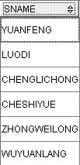
Cont…
The where-clause may be absent.
Find the Names of all students.
select Name from Students

Slide 21
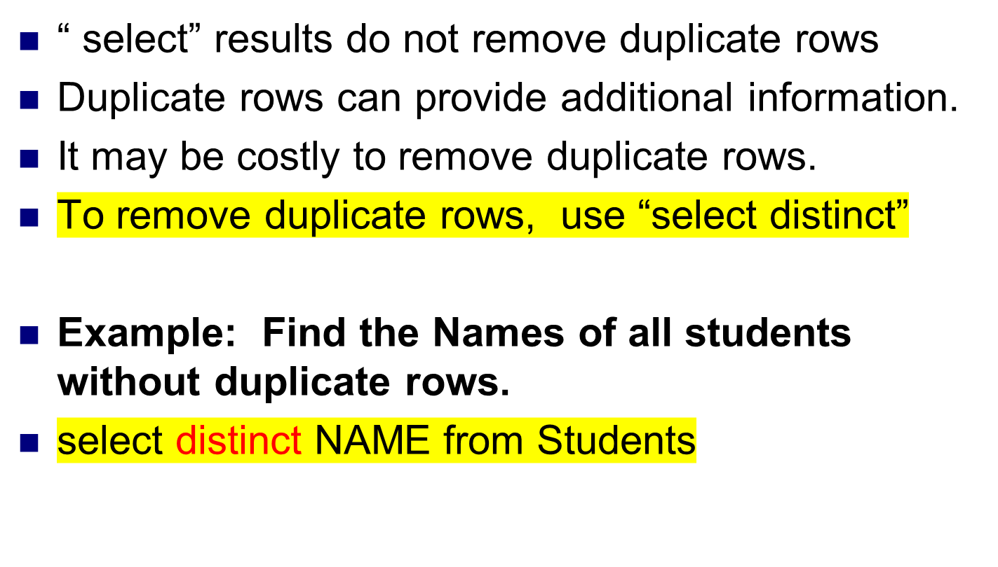
Cont…
如果需要删除重复的行，select本身不会去重

Slide 22
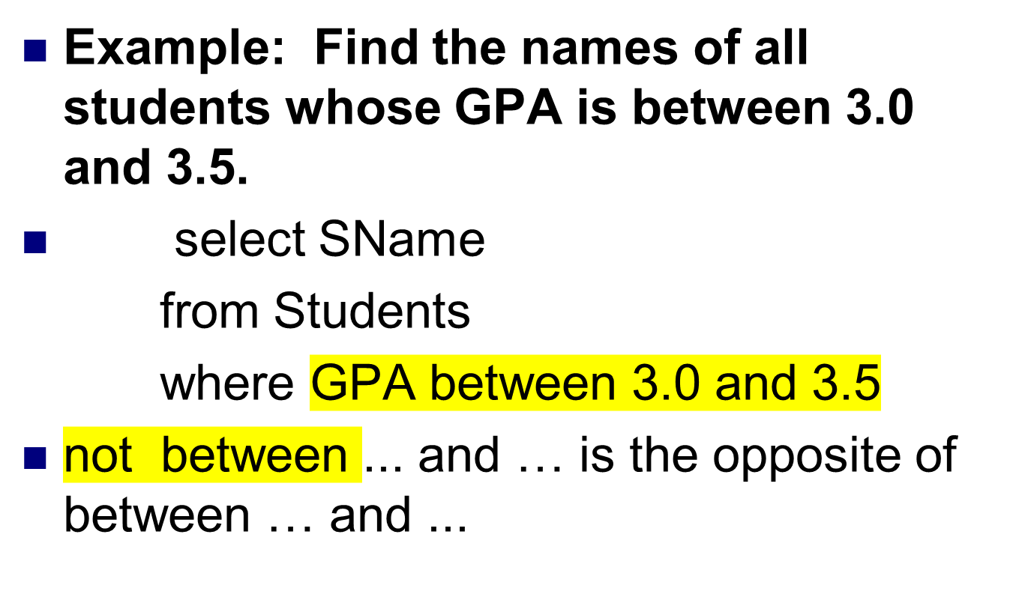
Between clause
3.0<=x<=3.5

Slide 23
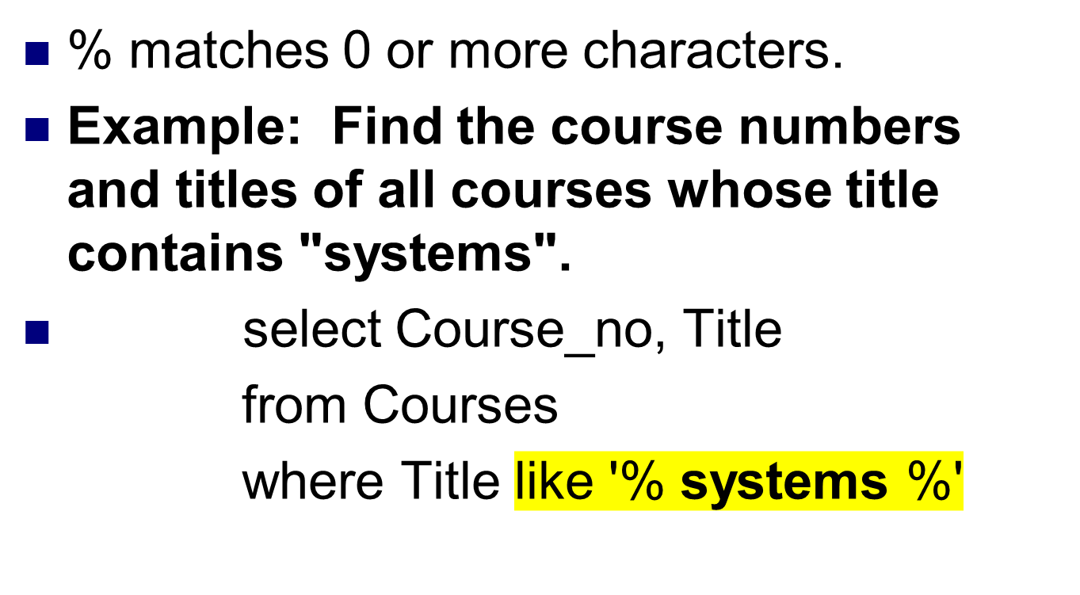
Like clause
%代表省略后面的一切字符，用于查找字段中有systems的记录

Slide 24
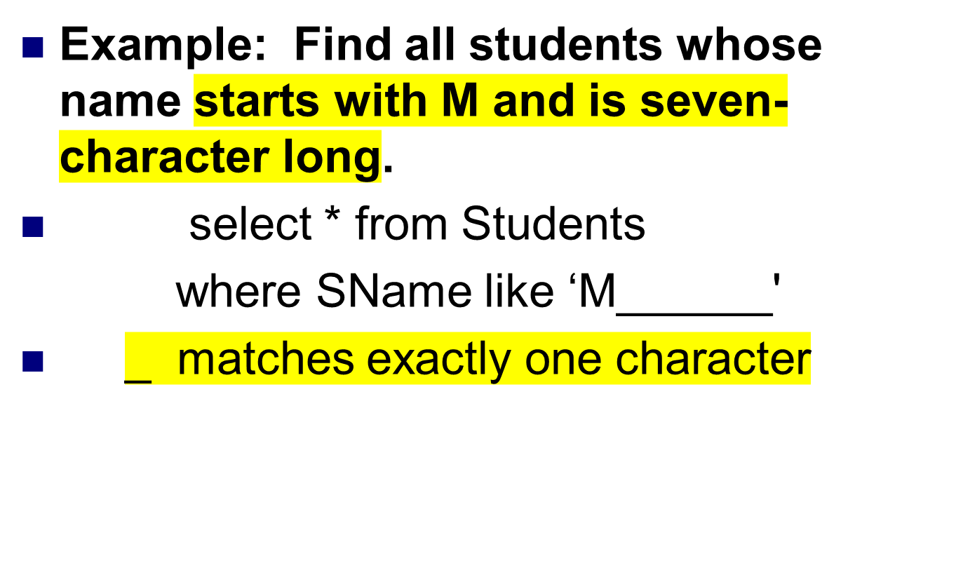
Cont…
一个_用于匹配一个字符

Slide 25
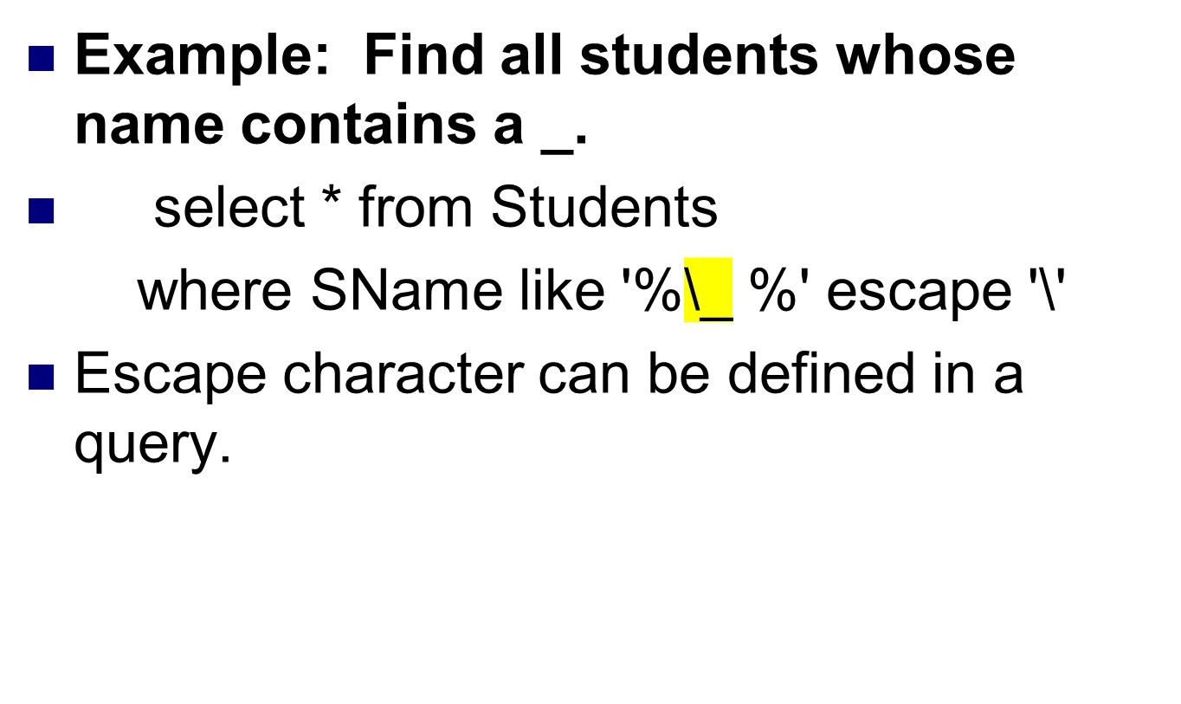
Cont…
\_ 表示转义字符
Notes:
转意字符

Slide 26
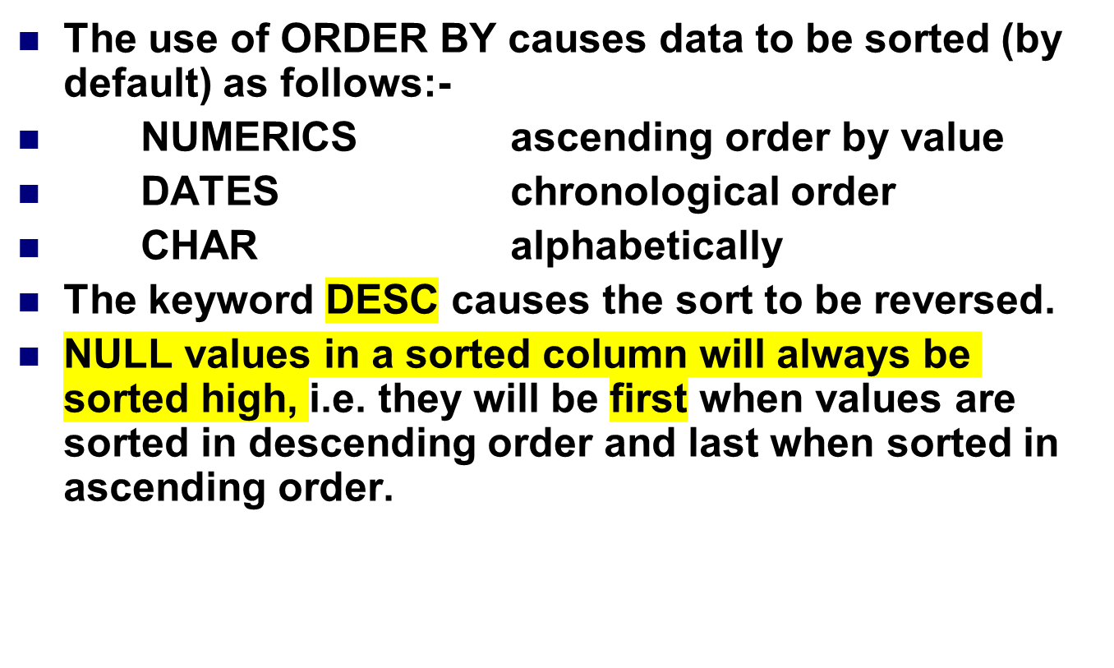
THE ORDER BY CLAUSE
Order by使数据排序
Desc使逆序排序
对于null值往往具有最大值的效果

Slide 27
Cont…
Shows the ID, name and hire date of employees with earliest hiredate first.
SELECT empno, ename, hiredate
FROM emp
ORDER BY hiredate;

Slide 28
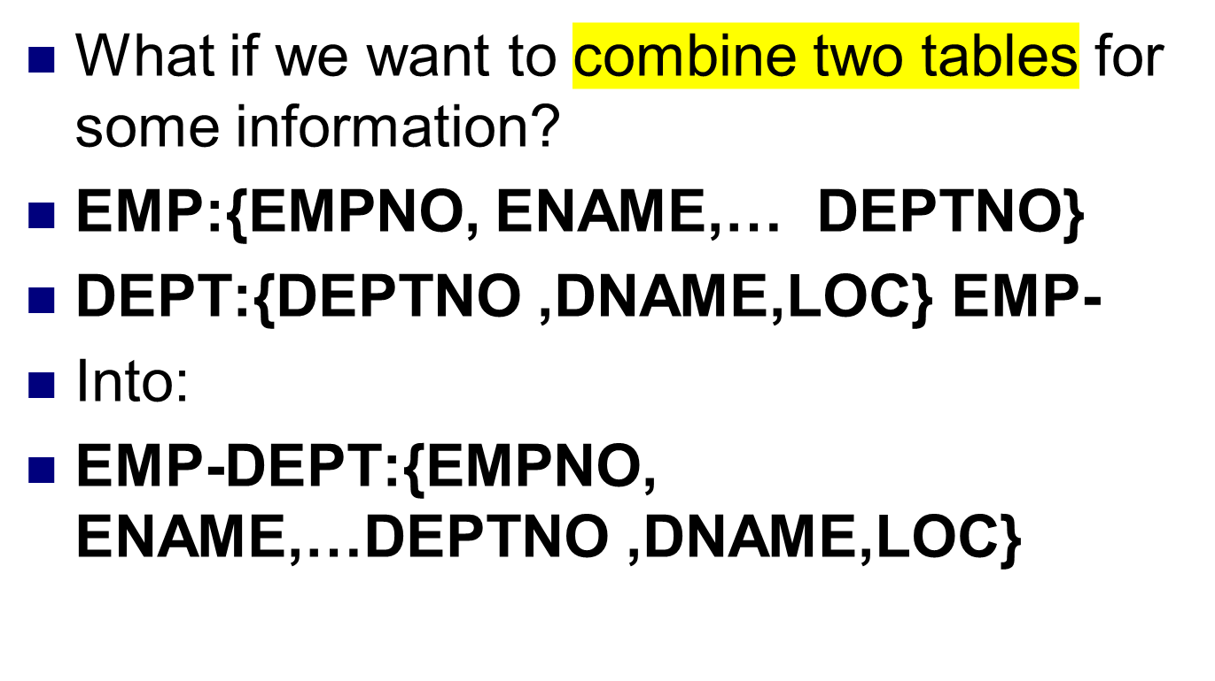
JOINING TABLES

Slide 29
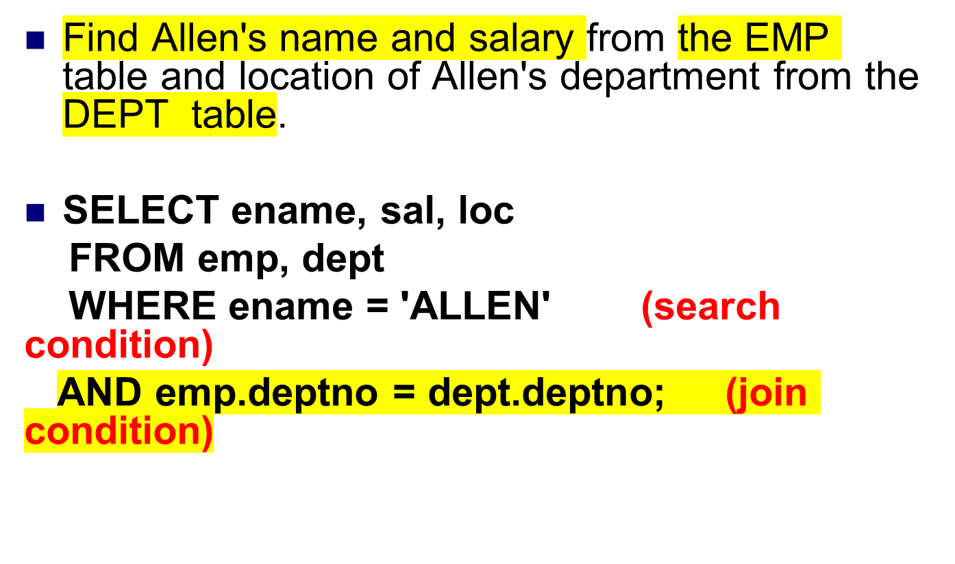
JOINING TABLES in SQL
连接条件：一般为外键约束

Slide 30
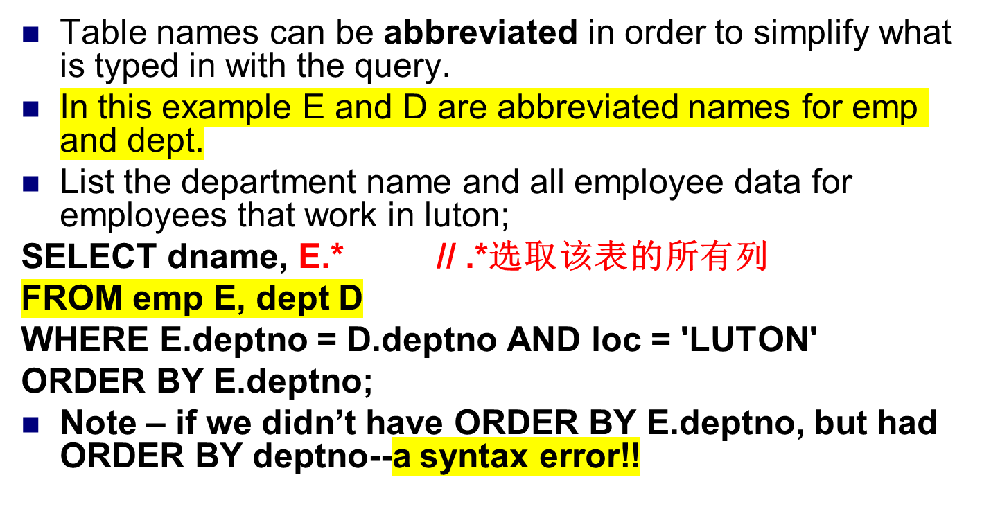
Alias for a table

Slide 31
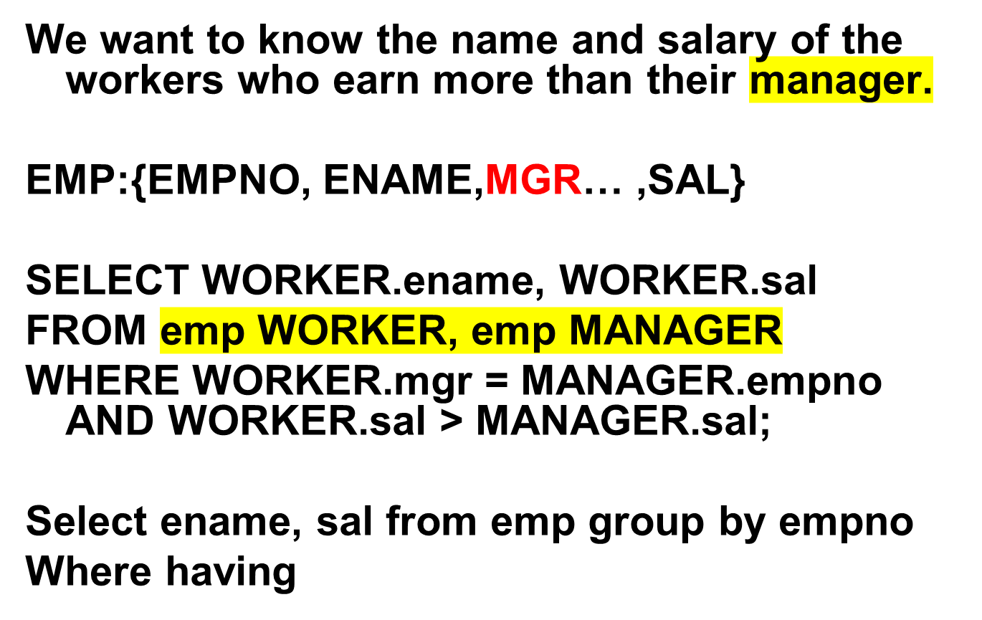
Joining a Table to Itself
Select共同字段需要使用别名或者表名
From 后面的表都会进行笛卡尔积

Slide 32
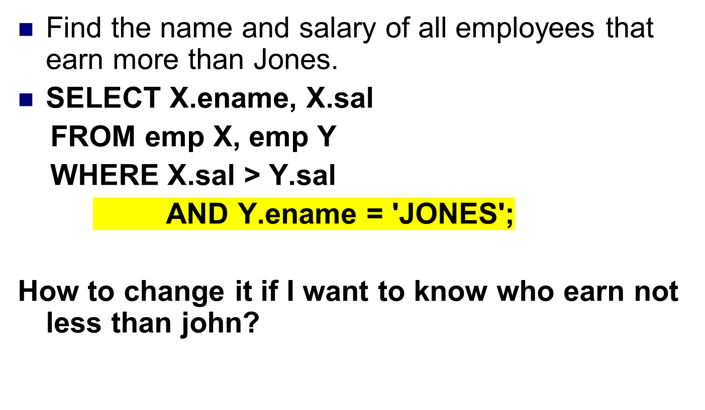
Cont…

Slide 33
Alias
Example: Find the names and GPAs of all students who take Course A.
select SName, GPA
from Students s, Enrollment e, Courses c
where Title = 'CourseA'
and s.SID = e.SID
and e.Course_no = c.Course_no
s, e and c are (relational) tuple variables (aliases, correlation names) for relations Students, Enrollment and Courses.
Tuple variables can be used to simplify query specification and save time.
Tuple variables are also useful when tuples from the same relation need to be compared.
Notes:
Tuple variable

Slide 34
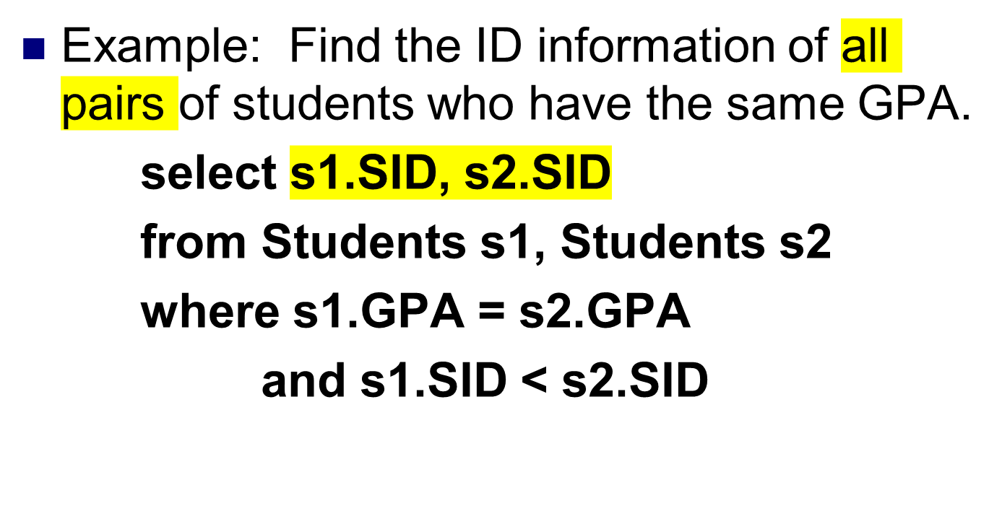
Cont…
直接写不等于会出现（A，B）和（B, A）的重复情况
Notes:
学生做

Slide 35
Cont…
Example: Find the names of all students whose GPA is higher than CHENSHI 's GPA.
select s1.SName
from Students s1, Students s2
where s2.SName = 'CHENGSHI'
and s1.GPA > s2.GPA
Notes:
Select name, GPA from student

Slide 36
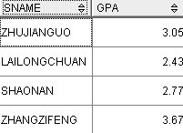
Cont…
Find the names and GPAs of all students who take database systems.
select SName, GPA from Students, Enrollment, Courses
where Title = `DBS‘ and
Students.SID = Enrollment.SID and
Enrollment.Course_no = Courses.Course_no

Slide 37
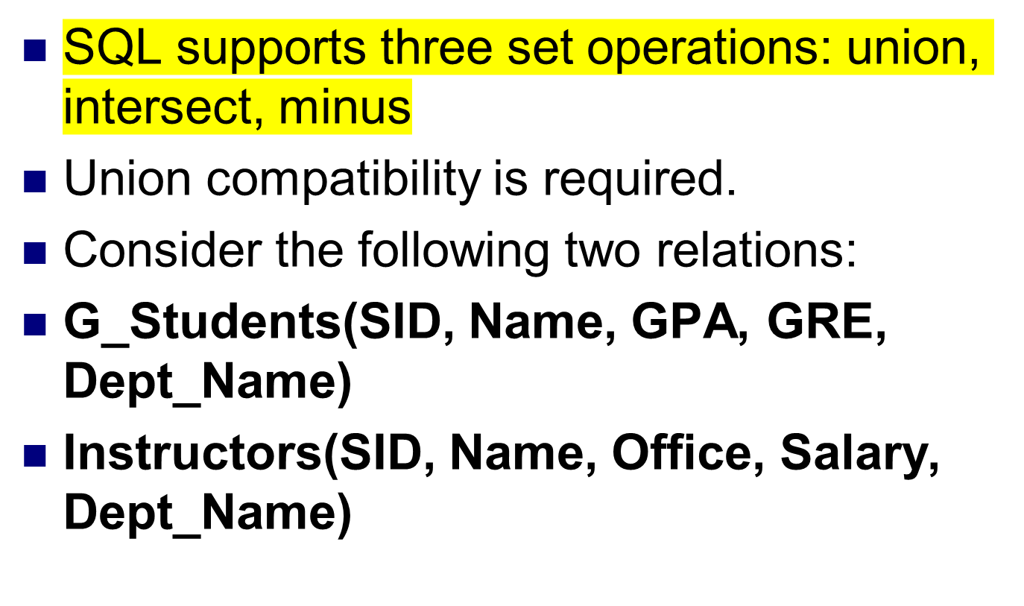
Set Operation :Union Intersect & Minus

Slide 38
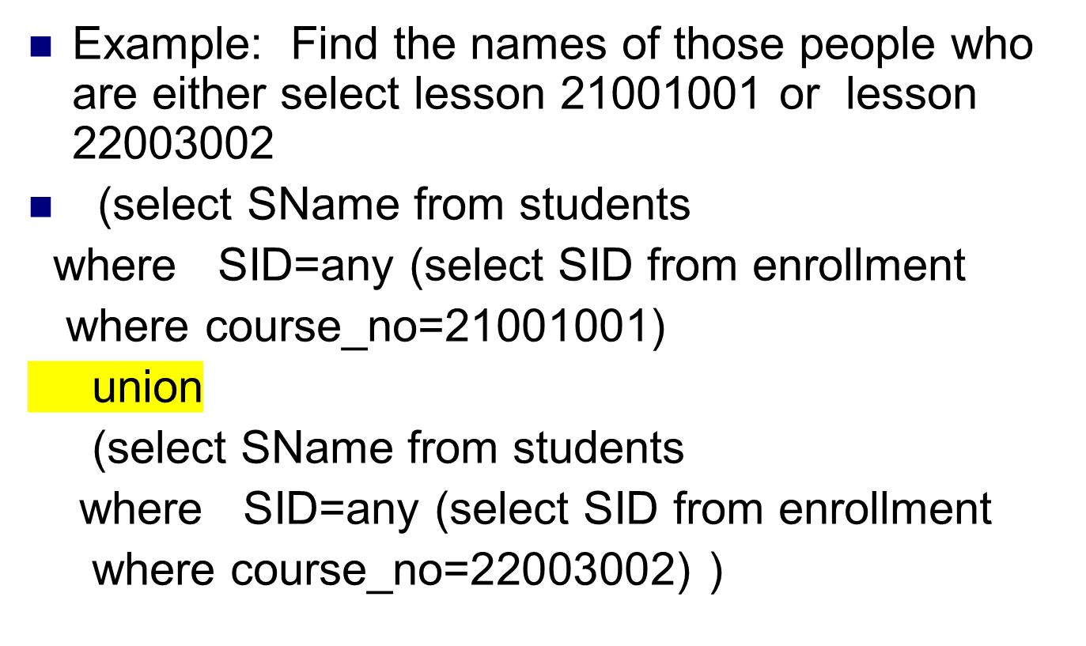
Union
Notes:
（）

Slide 39
Cont…
union removes duplicate rows.
union all keeps duplicate rows.

Slide 40
Set Operation: Intersect
Example: Find the names of those people who select lesson 21001001 and lesson 22003002
(select SName from students
where SID=any (select SID from enrollment
where course_no=21001001) )
intersect
(select SName from students
where SID=any (select SID from enrollment
where course_no=22003002) )
集合的交集
Notes:
Test in SQL

Slide 41
Set Operation: Minus
Example: Find the names of those who select lesson 21001001 but has not select the lesson 22003002
(select SName from students
where SID=any (select SID from enrollment
where course_no=21001001) )
minus
(select SName from students
where SID=any (select SID from enrollment
where course_no=22003002) )

Slide 42
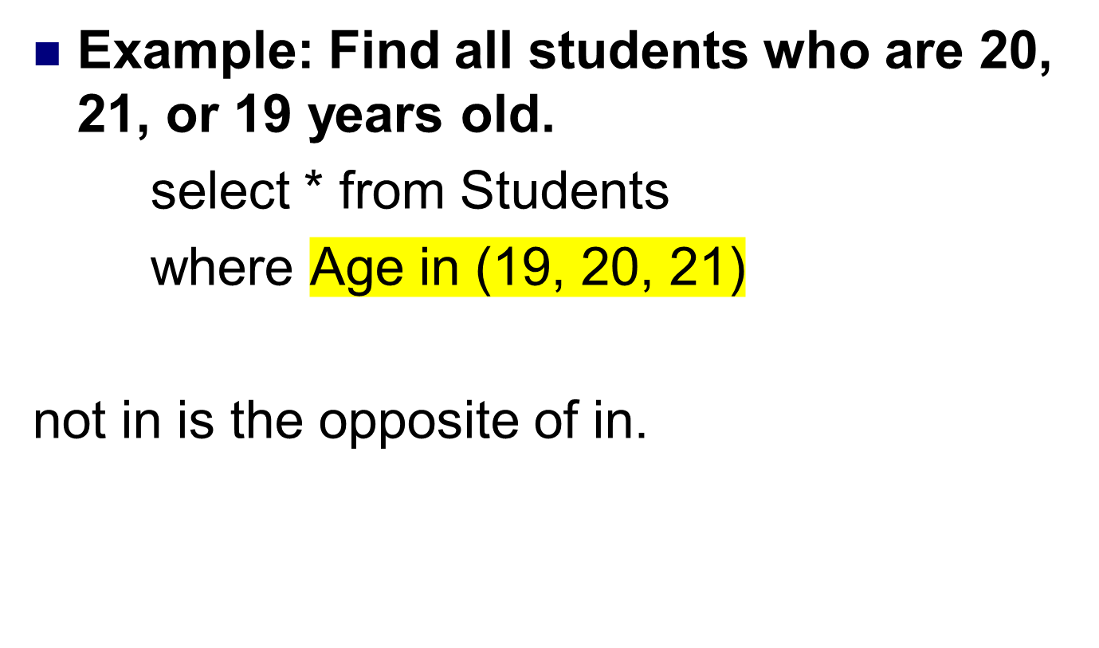
Set Operation: IN & NOT IN
In集合中

Slide 43
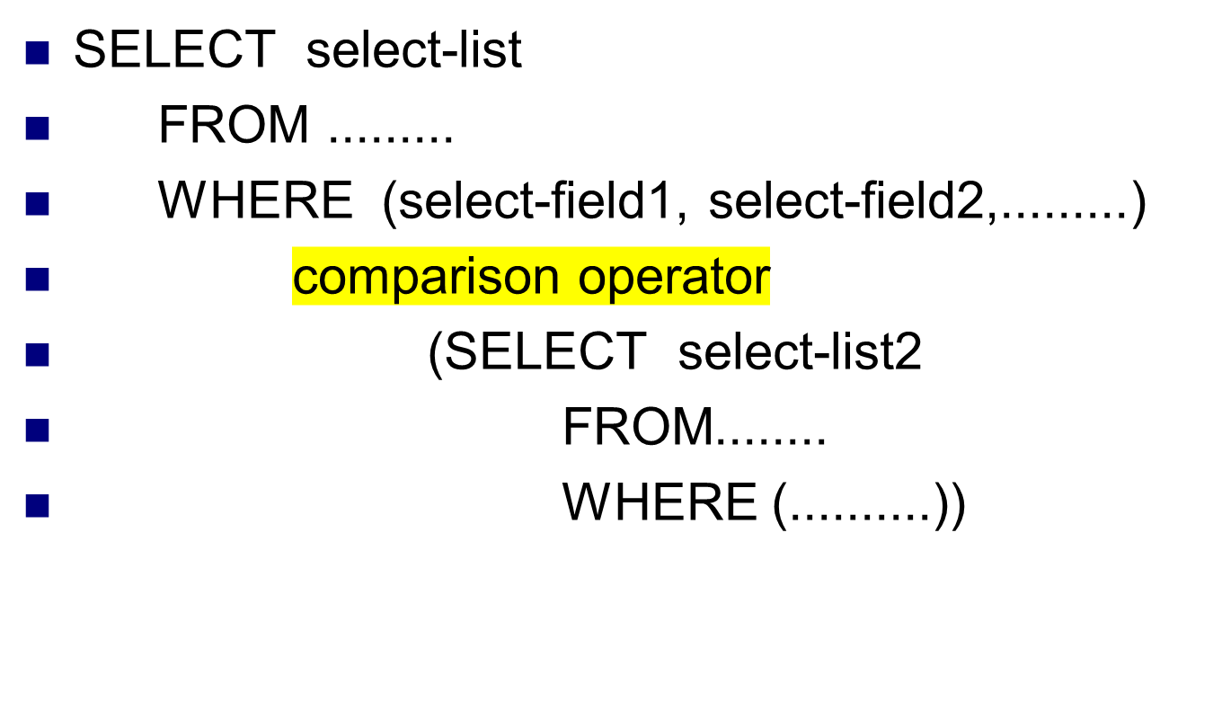
Nested Query

Slide 44
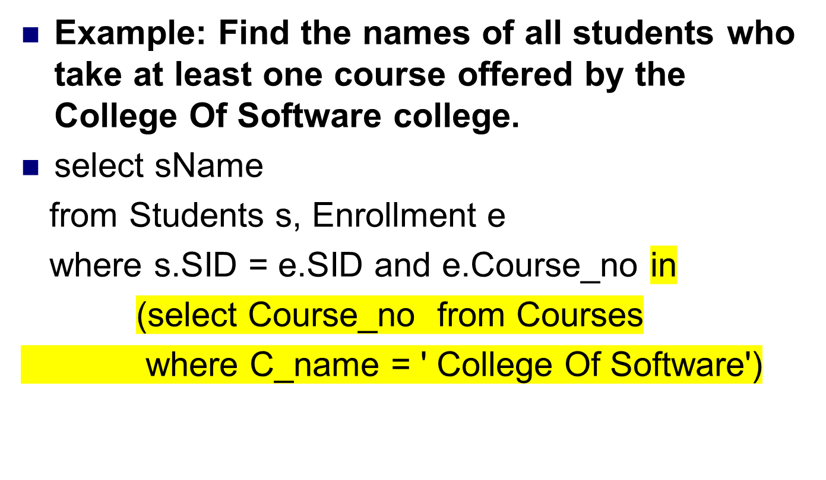
Nested Query

Slide 45
Cont…
(2)
select SName
from Students where SID in
(select SID from Enrollment
where Course_no in
(select Course_no from Courses
where c_name = 'College Of Software'))
笛卡尔积会在大数据时耗费大量的空间，空间效率低下
Notes:
学生做，nested

Slide 46
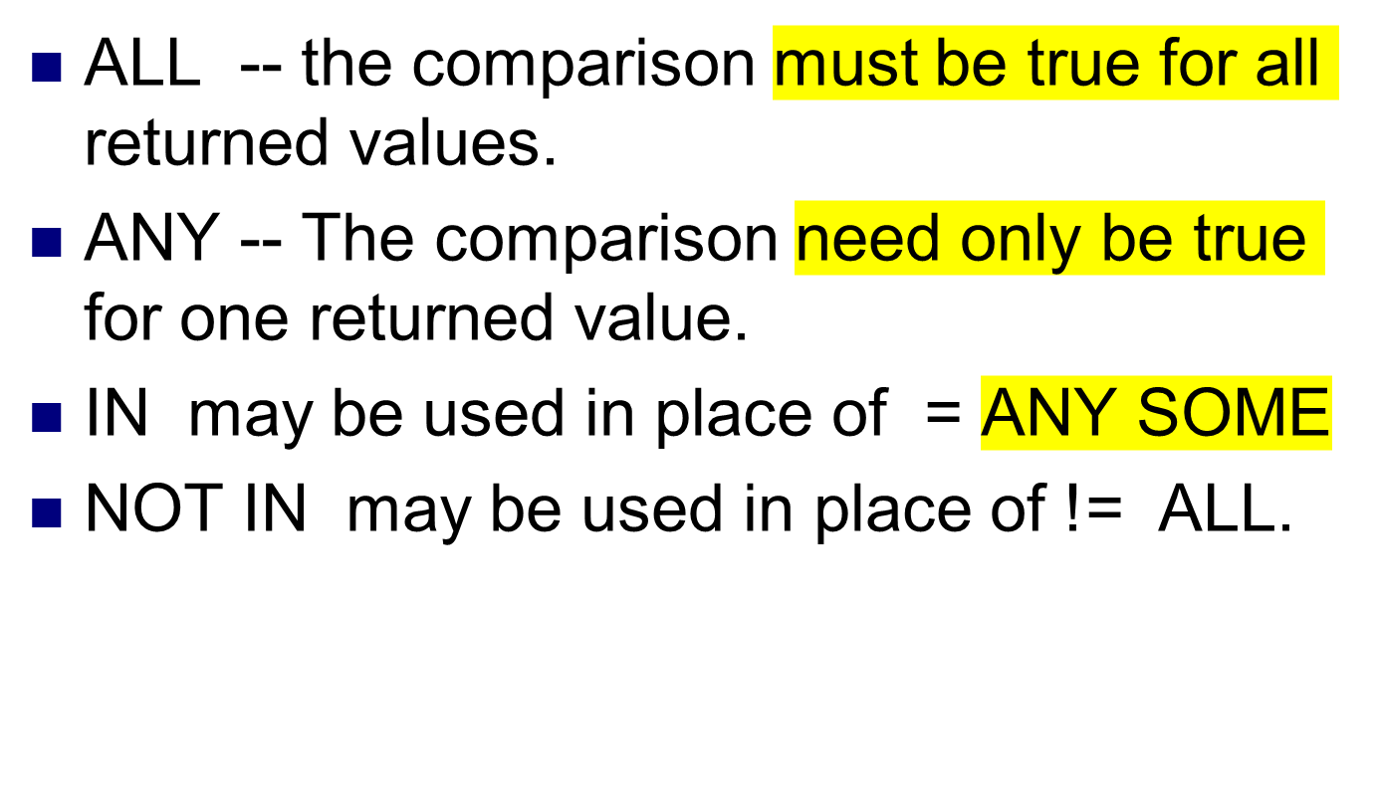
comparison-operator:

Slide 47
Cont…
The previous query is a nested query.
The query outside is an outer query and the query nested under the outer query is an inner query.
Multiple nesting's are allowed.
The semantics of the above query is to evaluate the inner query first and evaluate the outer query last.
Many nested queries have equivalent non-nested versions.

Slide 48
Non Nested Equivalent
The previous query is equivalent to:
(1) select SName from Students s, Enrollment e, Courses c
where s.SID = e.SID and e.Course_no =
c.Course_no and c.c_name = 'College Of Software '
Notes:
学生做，JOIN

Slide 49
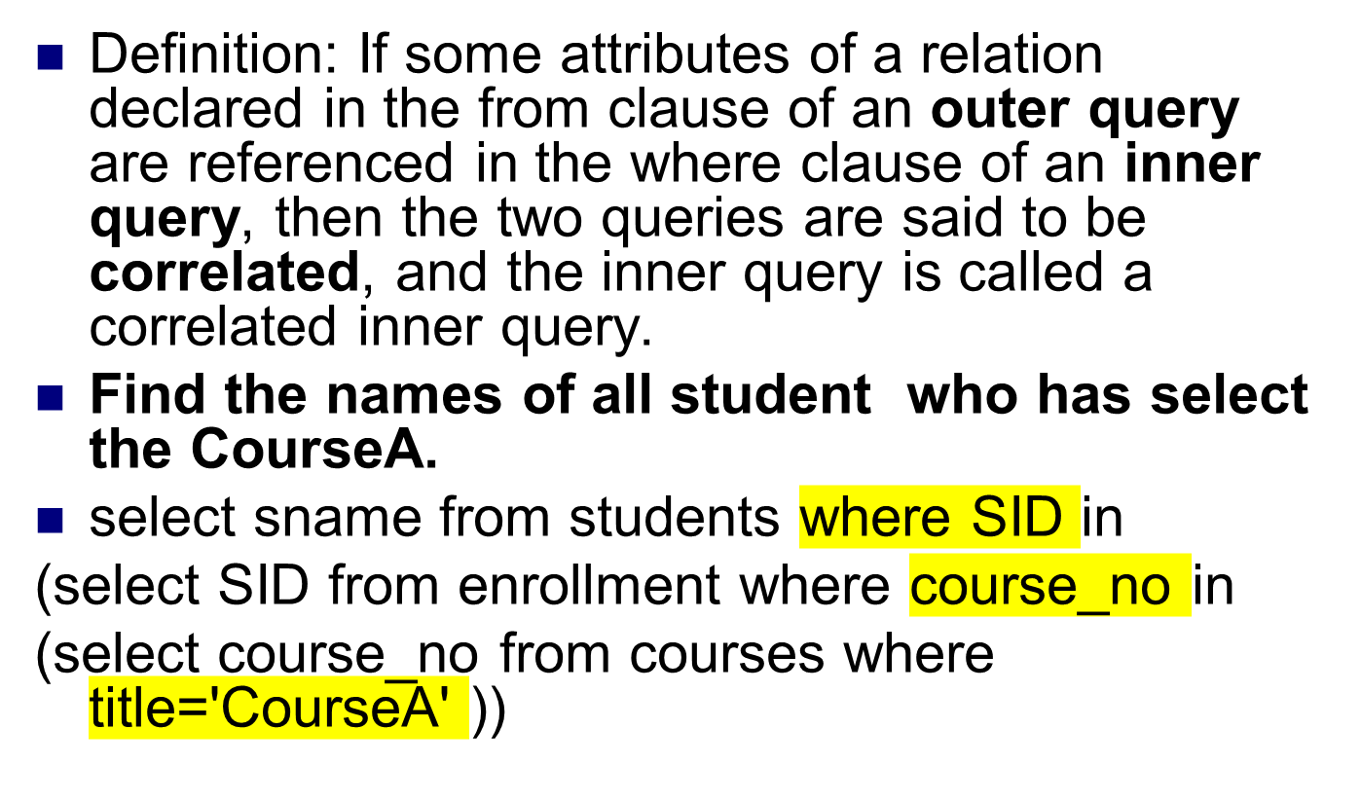
Correlated Query

Slide 50
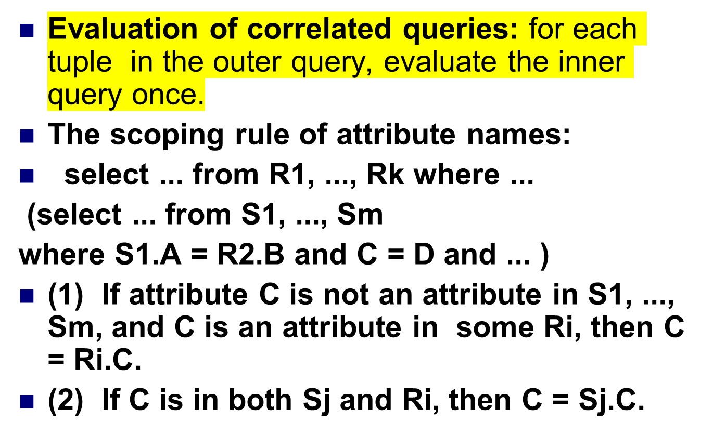
Cont…
相关性评价
Notes:
内部查询优先

Slide 51
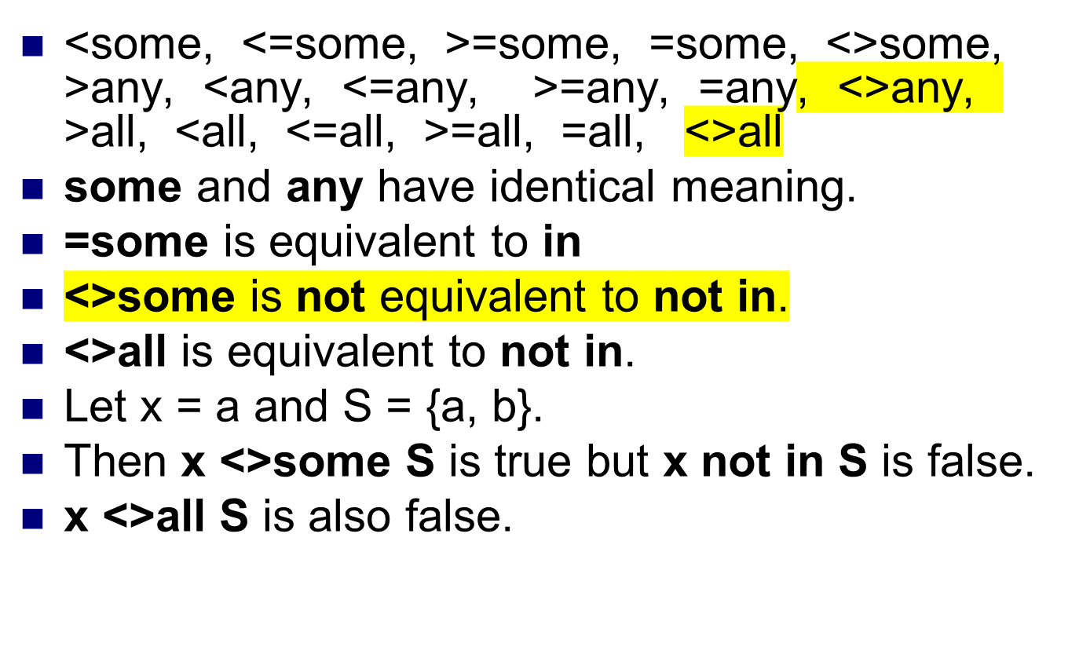
Other set comparison operators:

Slide 52
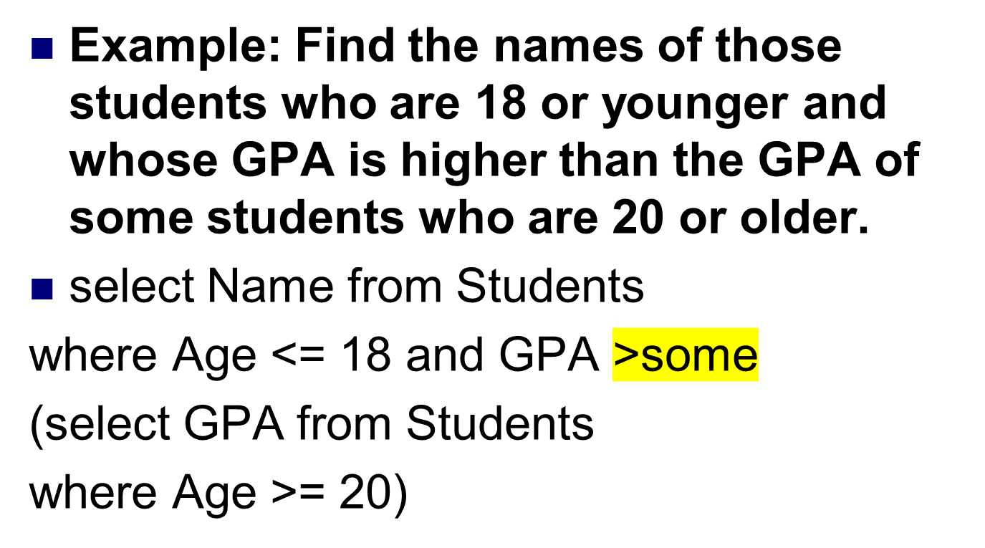
Cont…

Slide 53
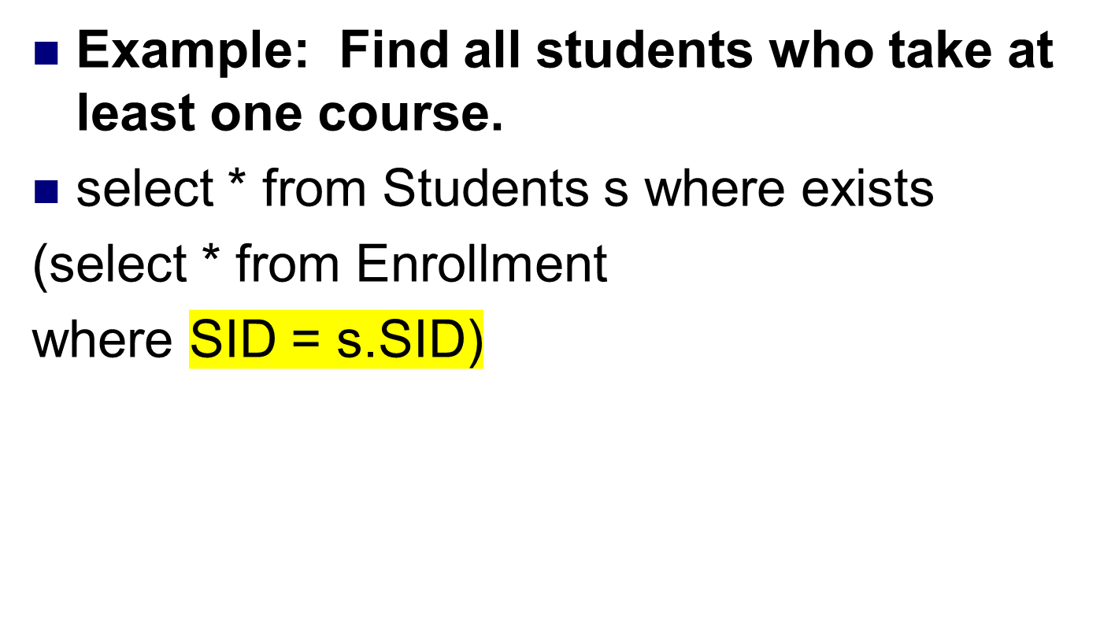
Exists
相关性

Slide 54
Exists and not Exists
exists ( ) is true if the set ( ) is not empty.
exists ( ) is false if the set ( ) is empty.
not exists ( ) is true if the set ( ) is empty.
not exists ( ) is false if the set ( ) is not empty.
集合是否为空，对应是否存在

Slide 55
Cont…
The previous query is equivalent to:
(1) select s.*
from Students s, Enrollment e
where s.SID = e.SID
(2) select * from Students where SID in
(select SID from Enrollment)
Notes:
JOIN, nested

Slide 56
Cont…
Find all students who do not take 21003001.
select * from Students s where not exists
(select * from Enrollment
where SID = s.SID
and Course_no = '21003001.')
This query is equivalent to: (nested query)
select * from Students where SID not in
(select SID from Enrollment
where Course_no = '21003001.')

Slide 57
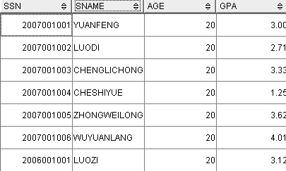

Slide 58
Find all the students who take all courses.
select * from Students s where not exists
(select * from Courses c where not exists
(select * from Enrollment
where SID = s.SID
and Course_no = c.Course_no))
考试必考

